Slide 1
The Effects of Prefetching to Computer
Shalin patel

Slide 2
What is Prefetching?
​Prefetching is a performance optimization tactic in which content that might be accessed by the user is downloaded in advance.
The browser (Chrome, Firefox, etc.) caches this content in the background, making it instantly available if the user clicks on a link that uses the content.

Slide 3
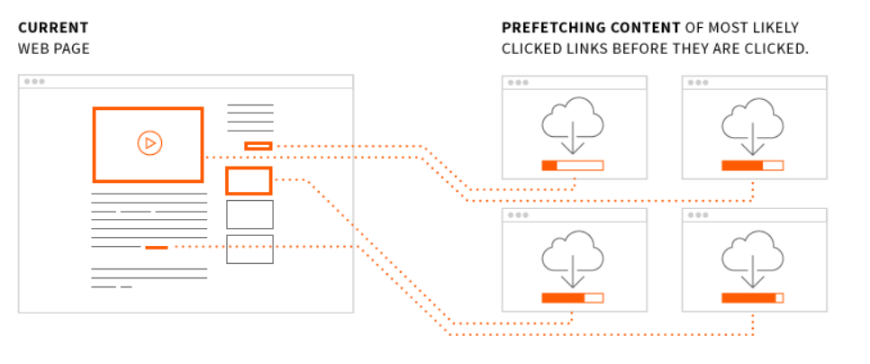
Prefetching (Cont’d) …

Slide 4
Types of Prefetching
DNS Prefetching
Prerendering

Slide 5
DNS Prefetching:
​A typical domain lookup can take anywhere from 1ms to several seconds depending on whether the domain name is cached locally. DNS prefetching reduces domain lookup times by resolving the domain name in advance.
E.g. Google Chrome

Slide 6
Prerendering
​While prefetching downloads the content of a webpage, prerendering renders the entire page in the background. The prerendered page is treated as a separate tab, so when the user clicks on a prerendered link the current tab is essentially replaced by the prerendered tab.
E.g. Online Periodicals

Slide 7
Benefits of Prefetching
​Users experience faster load times for web content.
Administrators see less spiked bandwidth usage.
Enterprises see higher visitor retainment.

Slide 8
Conclusion
​The fastest way to lose readers and customers is to make them wait for your website to load. Prefetching gets a one-up on latency by downloading web content before the user requests it.

Slide 9
References
Instruction prefetch. (n.d.). Retrieved from: https://ipfs.io/ipfs/QmXoypizjW3WknFiJnKLwHCnL72vedxjQkDDP1mXWo6uco/wiki/Instruction_prefetch.html
Daniel Z., Ruby L., Michael F. (August 2000). Hardware and Software Cache Prefetching Techniques for MPEG Benchmarks. Retrieved from: http://www.princeton.edu/~rblee/ELE572Papers/HW%26SWcachePrefetchMPEG_ZuckerLee.pdf
Jun Y. (2003). Prefetching. Retrieved from: https://pdfs.semanticscholar.org/ded4/a0260c7c8fd239bcc54be6e517f1870679b4.pdf
Abdel B., Aneesh A., Donald Y., Chau T. (2004). The Efficacy of Software Prefetching and Locality Optimizations on Future Memory Systems. Retrieved from: https://www.jilp.org/vol6/v6paper7.pdf
Wikipedia. Cache Prefetching. Retrieved from: https://en.wikipedia.org/wiki/Cache_prefetching
Optimizing Computer Runtime Using Data Prefetching and Code Optimization. (n.d.). Retrieved from: https://www.cis.rit.edu/class/simg707/Web_Pages/alain.htm
Stackpath. https://www.maxcdn.com/one/visual-glossary/prefetching/

